Slide 1
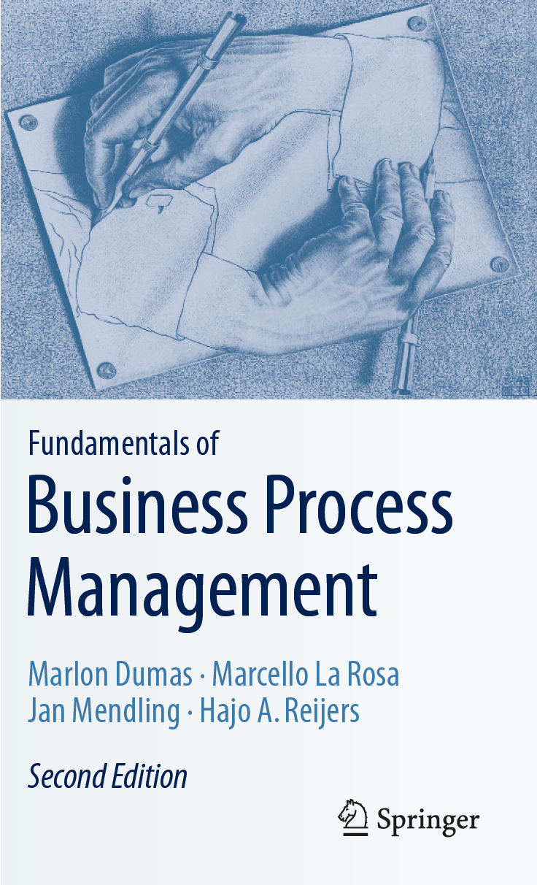
Chapter 5: Process Discovery
Contents
The Setting of Process Discovery
Process Discovery Methods
Process Modeling Method
Process Model Quality Assurance
Recap

Slide 2

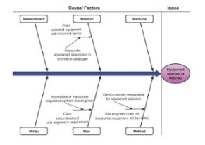
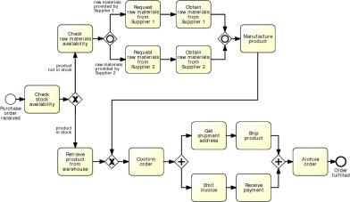
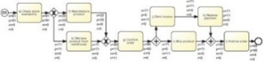
Process Modeling in the BPM Lifecycle

Slide 3
Chapter 5: Process Discovery
Contents
The Setting of Process Discovery
Process Discovery Methods
Process Modeling Method
Process Model Quality Assurance
Recap

Slide 4
Process discovery
Four main tasks:
Define the setting: assemble a team that will be responsible for managing the process
Gather information: build an understanding of the process. Different discovery methods available
Conduct the modeling: do the actual modeling
Assure model quality: guarantee that the resulting model meets different quality criteria
done together

Slide 5

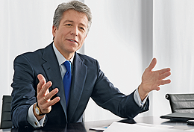
Who is involved?
Process analyst
Domain expert

Slide 6
Example: modeling perspective
Consider the following two modelling tasks:
Modeling the process for ordering books through an online bookstore, from the perspective of the customer.
Modeling the same process from the perspective of the bookstore.
Which of the two tasks above are you familiar with and why?

Slide 7
Exercise 5.1
You are the manager of a consulting company and you need to hire a person for the newly signed BPM project with an online bookstore. Consider the following two profiles; who would you hire as a process analyst?
Mike Miller has ten years of work experience with an online retailer. He has worked in different teams involved with the order-to-cash process of the online retailer.
Sara Smith has five years of experience working as a process analyst in the banking sector. She is familiar with two different process modeling languages and with several modeling tools.

Slide 8


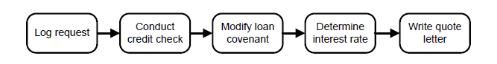


Challenge 1: Fragmented process knowledge
I make a photocopy before handing over the application
Iterative validation process
Why can‘t I directly provide cash after approval?
We bundle refinancing to get better interest rates.

Slide 9

Challenge 2: Domain experts think on instance level
“Every trip is different”
“You cannot really compare. Our customers go to different places in different seasons using different modes of transportation”
“We can never do anything exactly in the same way. There are so many special conditions”
Abstraction from instance level to process level

Slide 10
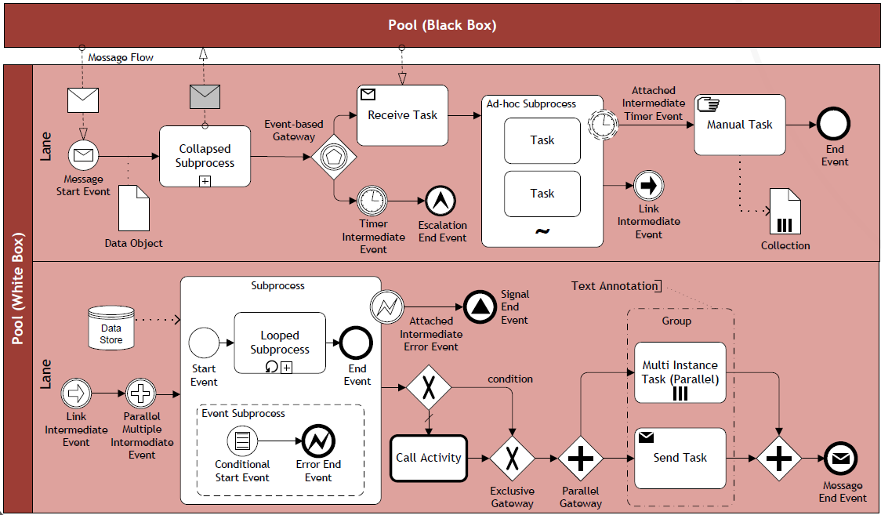
Challenge 3: Knowledge of process modeling is uncommon
“Does this diagram correctly show your process?”
Translation to natural-language

Slide 11
What makes a good process analyst?
Getting the right people on board
Formulate and test hypotheses
Identify patterns
Pay attention to model quality

Slide 12
Exercise 5.2
Consider the order-to-cash process of your preferred online bookstore and assume you have access to three internal resources: a customer relationship manager (who handles sales and reclaims), a warehouse worker (who looks after shipments), and a financial officer (who raises invoices and collects payments). As a process analyst, what questions do you need to ask these domain experts to be able to obtain a complete and systematic view of this process?
Hint. Think of the different exposure to this process that the three resources have and of the possible conditions, process outcomes, and exceptions that they may have experienced while executing this process.

Slide 13
Profile of an Expert Process Analyst
Getting the right people on board
Having a set of working hypotheses of how the process is structured at different levels of detail
Identifying patterns in the information provided by domain experts
Paying attention to model quality

Slide 14
Chapter 5: Process Discovery
Contents
The Setting of Process Discovery
Process Discovery Methods
Process Modeling Method
Process Model Quality Assurance
Recap

Slide 15


Process discovery methods
Evidence-based
Document analysis
Observation
Automated process discovery
Interview-based
Workshop-based
Choose one or more on the basis of context and budget

Slide 16

Document Analysis
Documents point to existing roles, activities and business objects:
Process descriptions (ideal scenario)
Internal policies
Organization charts
Employment plans
Quality certificate reports
Glossaries and handbooks
Forms
Work instructions…
Could be used to gather information before approaching domain experts.
Potential issues:
May not be process-oriented and trustworthy
May require abstraction or refinement

Slide 17

Observation
Follow directly the execution of individual process instances, then abstract from instance to process level:
Active role: play a specific role, e.g. customer
Passive role: observe participants and their environment
Trace business objects in the course of their lifecycle
Potential issues:
Active role: no big picture
Passive role: participants’ bias

Slide 18

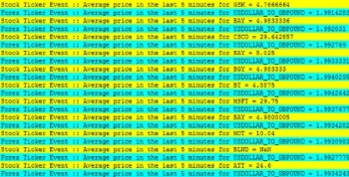
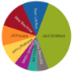
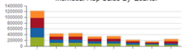

Automated process discovery and Process mining
Discovery
discovered model
event stream
Enhancement
enhanced model
event log
existing model
DB
Conformance
✓/✗

Slide 19
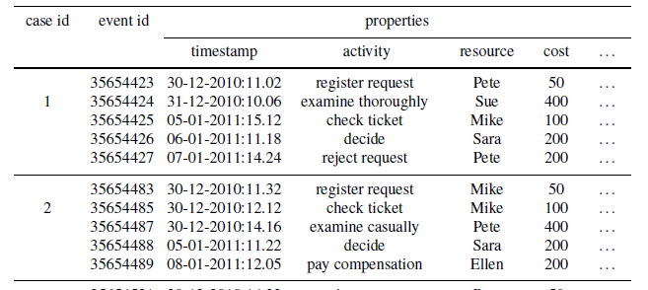
Automated discovery: Minimum data requirements
Activity name and timestamp
Reference to case id
Additional information:
Activity resource, cost
Case attributes (e.g. customer reference, type of case…)

Slide 20
Exercise 5.3
As a process analyst working for the University of Newtown, you have been engaged by Mark Johnson, the process owner of the student admission process, in a project that aims at improving this process. In order to model the as-is process, you start by collecting relevant information about this process. The available documentation includes the organization chart of the Office of the Deputy Vice-Chancellor (DVC) for Student Affairs where Mark’s team sits, the UML class diagram of the student admission system which supports this process, and a set of relevant organizational policies that you extract from the university’s Web pages.
Based on this documentation, formulate initial hypotheses on how the student admission process works. Next, identify the relevant domain experts to interview and their supervisors whom you should seek approval from.

Slide 21
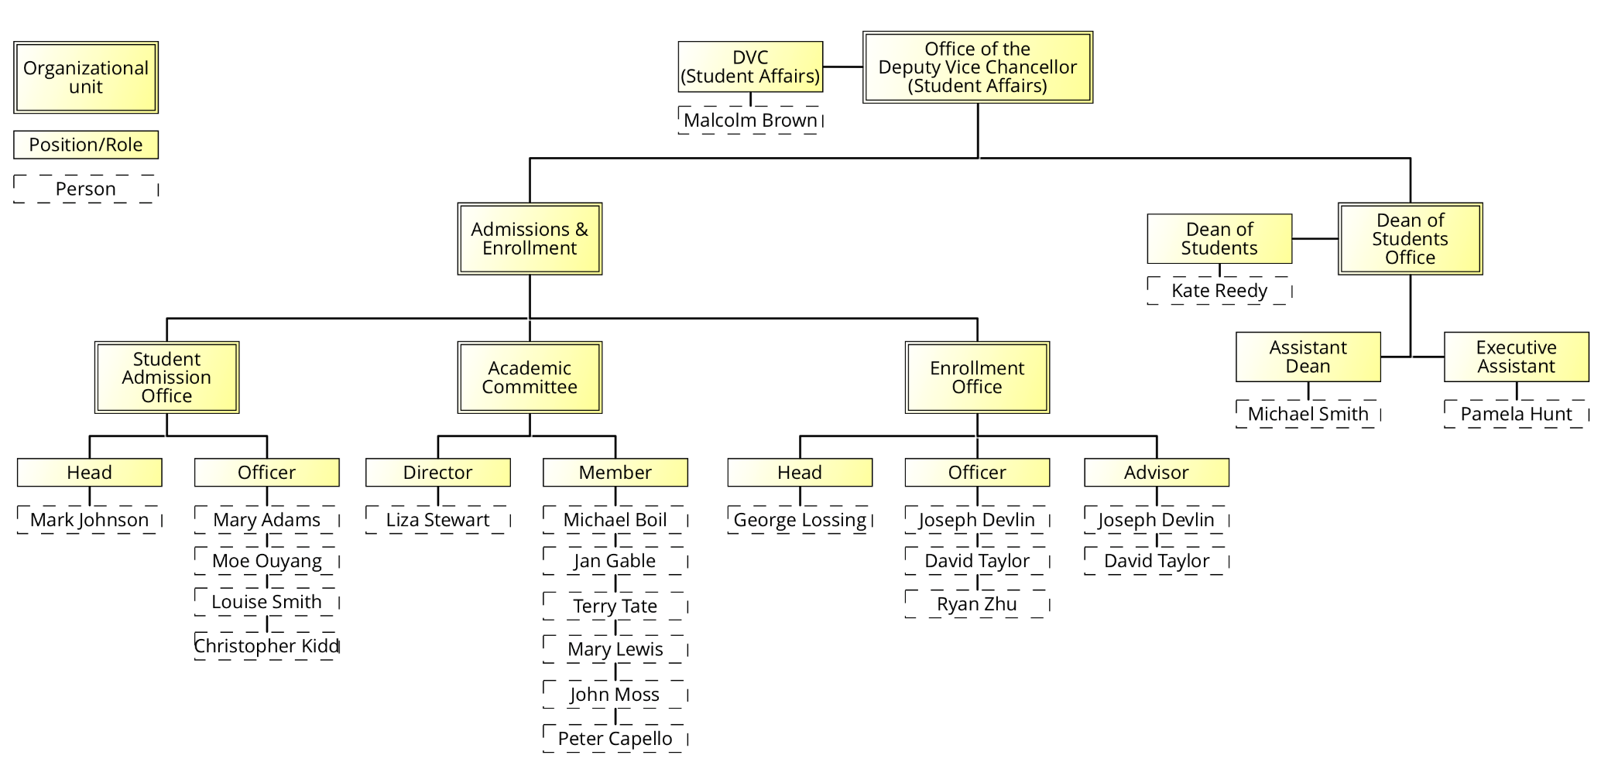
Exercise 5.3 (cont’ed)
Organizational chart of the Office of the DVC (Student Affairs)

Slide 22
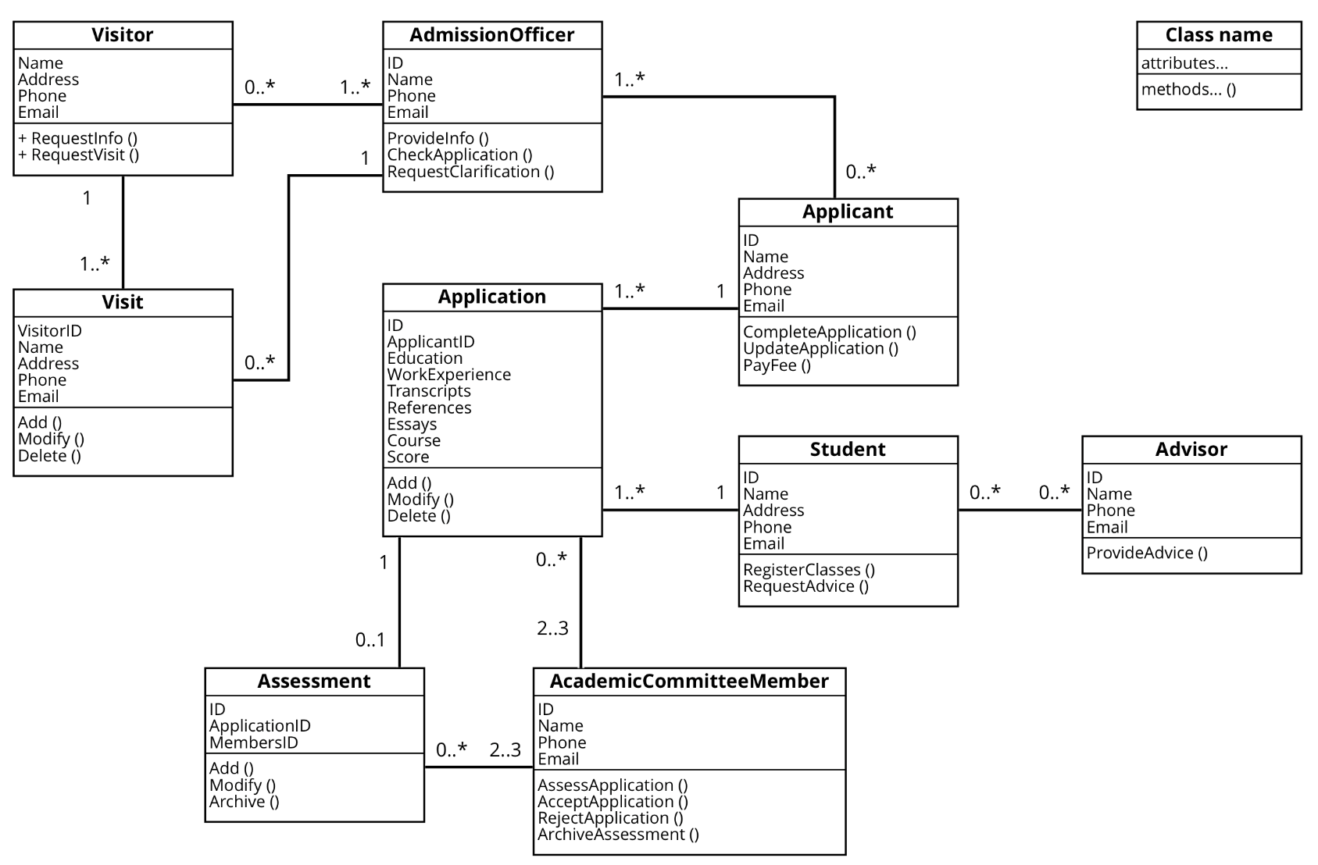
Exercise 5.3 (cont’ed)
Extract of the UML class diagram of the student admission system

Slide 23
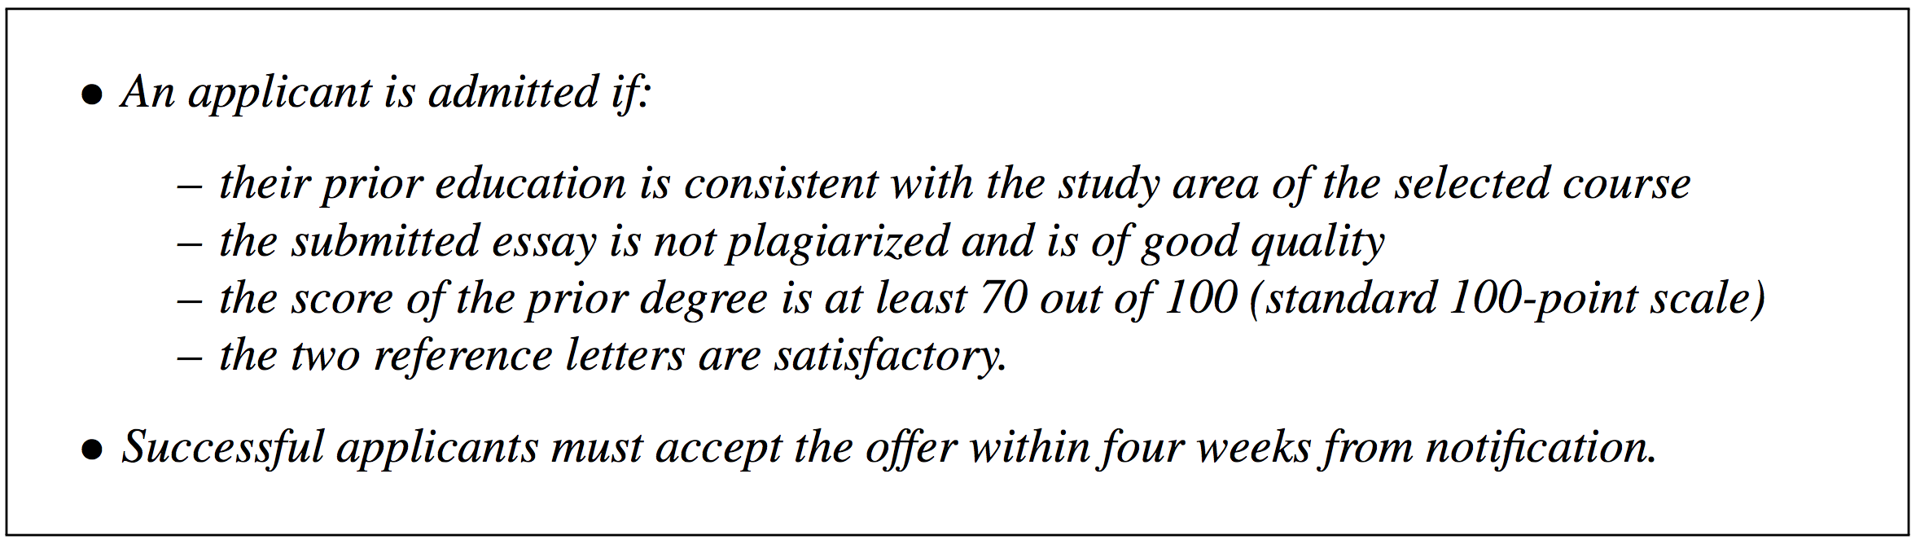
Exercise 5.3 (cont’ed)
Organizational policies for student admission

Slide 24
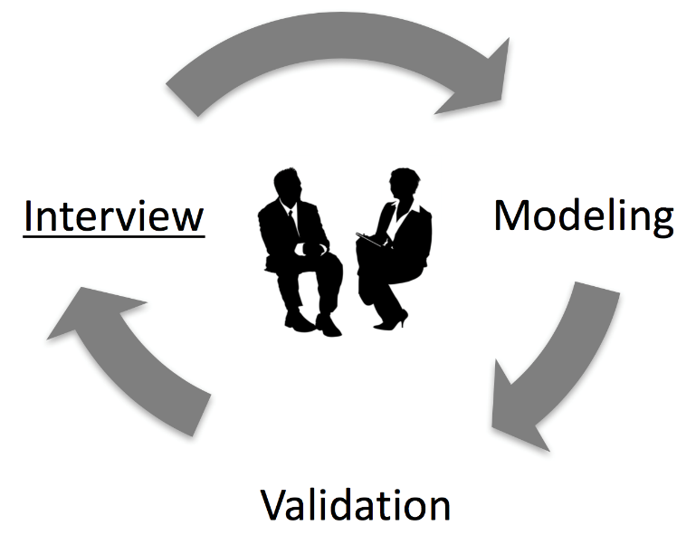
Interview-based Discovery
Approaches:
forward vs backward
structured vs unstructured
Assumption: analyst and domain expert share terminology
Pitfall: exceptional behavior tends to be neglected > use questions that aim to identify such behavior

Slide 25
Exercise 5.4
After collecting relevant information on the student admission process, you interviewed some representatives for the two roles involved in this process: Mary Adams and Louise Smith as student admission officers, and Peter Capello as a member of the academic committee (Mark Johnson, the process owner, confirmed that the enrollment office is not involved in this process). The relevant parts of the interview transcripts are provided below.

Slide 26
Exercise 5.4 (cont’ed)
Student admission officer (Mary Adams):
“My process starts when I receive an application for admission. First, I check the completeness of this document. If the application is incomplete, I need to send a request for clarification back to the applicant. Otherwise, I forward it to the academic committee. I then receive a response from the academic committee which can be either of the below:
A notification of acceptance from the academic committee. In this case, I prepare a letter of offer and send it to the applicant via post to collect his or her signature. Most of the times, I receive a signed offer back from the applicant, but sometimes I don’t.
A notification of rejection. In this case, I send a rejection letter to the applicant via ordinary post.
The problem is that the academic committee is often too slow to reply. I wonder if these academics are just too overloaded with work to care about student admissions...”

Slide 27
Exercise 5.4 (cont’ed)
Student admission officer (Louise Smith):
“When I get a fresh application, it’s important that this contains all the required information, including name, address, phone number and email address of the applicant. Unfortunately, the Web portal has many bugs and sometimes lets through incomplete applications, which are a nightmare to rectify! This means going back and forth with the student at least a couple of times. Anyway, once the application is complete, I pass it to a member of the academic committee using our internal student admission system – the same that collects applications via the Web portal. Most of the times, the member of the academic committee replies with a notification of acceptance, in which case I need to prepare a letter of offer and send it to the applicant via post. Our policies are such that applicants must reply within four weeks. In fact, we are flooded by applications, so if they do not hurry to reply, we will offer the place to someone else. Sometimes I receive a notification of rejection. Well, in this case I formulate a rejection letter and send it to the applicant via post.”

Slide 28
Exercise 5.4 (cont’ed)
Member of academic committee (Peter Capello):
“When I receive an application from the admission officer, I assess its quality. I extract the grade of the applicant from his or her previous degree and convert it to a standard score based on a conversion table. The score must be at least 70%; otherwise the student is out. Next, I perform a plagiarism check of the essay contained in the application using our pla- giarism detection software. Most of the times, the essay is plagiarism-free. If so, I proceed to read it and assign it a score. Finally, I read the two reference letters attached to the appli- cation. There’s a lot you can learn from a reference letter. Often there are subtle messages that the referee wants you to get, like “This is a great student, but I’ve had better ones”. In any case, based on the score, quality of the essay and reference letters, if I deem that the applicant is qualified, I send an acceptance notification to the admission officer, otherwise I send a rejection notification. In either case, I archive the results of my assessment in my database. Ah, I communicate with the student admission office using our internal student admission system. A piece of junk, sometimes messages get lost and I have to send them again, if I’m lucky to find it out!”

Slide 29
Exercise 5.4 (cont’ed)
Next, you took an active role in observing how this process works by acting as the applicant. Using a fake identity (in agreement with the process owner), you triggered this process several times by submitting various applications via the Web portal. Af- ter this, you came up with the following observations.

Slide 30
Exercise 5.4 (cont’ed)
Applicant:
To apply for admission, the applicant needs to prepare an admission application and submit it to the university via a Web portal. The application must include academic transcripts, an essay and two reference letters. The applicant will then receive a response from an admission officer via ordinary mail, which can be:
A letter of offer. In this case, the applicant needs to sign the letter of offer and return it to the admission officer via post within four weeks.
A rejection letter. In this case, the applicant does not do anything further and the pro- cess is finished.
A request for clarification from the admission officer. This is an email notification. In this case, the applicant provides the required documentation to the admission officer by submitting an updated application through the same Web portal used for the initial submission, and then gets a response that is the letter of offer, the rejection letter, or again a request for clarification.

Slide 31
Exercise 5.4 (cont’ed)
Using the information above, create a draft BPMN model of the as-is student admission process. This draft will then be validated with the people that have been interviewed, before sign-off by the process owner. Make appropriate assumptions.

Slide 32
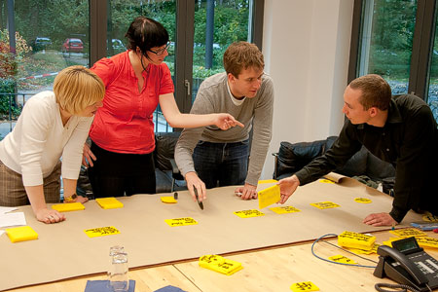
Workshop-based Discovery
Gather all key stakeholders together
Participants interact to create shared understanding
Typically one process analyst (facilitator), multiple domain experts, process owner may also attend
May be software-supported – a model is directly created during the workshop (typically a separate role – tool operator)
Model is used as a reference point for discussions
Alternative: brown-paper workshops
Usually 3 to 5 half-day sessions

Slide 33


Example: Any difference in discovery?
Consider the following two companies:
Company A is young, founded three years ago, and has grown rapidly to a current toll of one hundred employees.
Company B is owned by the government and operates in a domain with extensive health and security regulations.
How might these different characteristics influence a workshop-based discovery approach?

Slide 34
Discovery and Culture
Before starting with process discovery, it is important to understand the culture and the sentiment of an organization.
There are companies that preach and practice an open culture in which all employees are encouraged to utter their ideas and their criticism. Such organizations can benefit a lot from workshops as participants are likely to present their ideas freely.
In strictly hierarchical organizations, it is necessary to take special care that every participant gets an equal share of parole in a workshop and that ideas and critique are not held back.
It might be the case that the young dynamic company has a more open culture than the company with extensive health and security regulations. This has to be taken into account when organizing a workshop.

Slide 35
Exercise 5.5
Consider the complaints that have emerged from the interviews reported in Exercise 5.4. As a facilitator, what questions would you ask the various participants to investigate these further in a workshop?

Slide 36
Discovery methods: strengths and weaknesses
Aspect | Evidence-based | Interviews | Workshops
Objectivity | High | Medium-high | Medium-high
Richness | Medium | High | High
Time consumption | Low-medium | Medium | Medium
Immediacy of feedback | Low | High | High

Slide 37
Discovery methods: strengths and weaknesses
Method | Strength | Weakness
Document Analysis | Structured information Independent from availability of stakeholders | Outdated material Wrong level of abstraction
Observation | Context-rich insight into process | Potentially intrusive Stakeholders likely to behave differently Only few cases
Automatic Discovery | Extensive set of cases Objective data | Potential issue with data quality and level of abstraction
Interview | Detailed inquiry into process | Requires sparse time of process stakeholders Several iterations required before sign-off
Workshop | Direct resolution of conflicting views | Requires availability of several stakeholders at the same time

Slide 38

In what situations is it simply not possible to use one or more of the described discovery methods?

Slide 39
Exercise 5.6
The order-to-cash process of your favorite online bookstore has ten major activities conducted by ten people with five different roles. How much time do you approximately need for creating a process model that is validated by the various stakeholders and approved by the process owner?
Consider two scenarios: one in which you run interviews, the other in which you run workshops. You may also use other discovery methods in these two scenarios, in addition to either inter- views or workshops. Can you estimate the difference in time effort between the two scenarios? Make appropriate assumptions.

Slide 40
Chapter 5: Process Discovery
Contents
The Setting of Process Discovery
Process Discovery Methods
Process Modeling Method
Process Model Quality Assurance
Recap

Slide 41
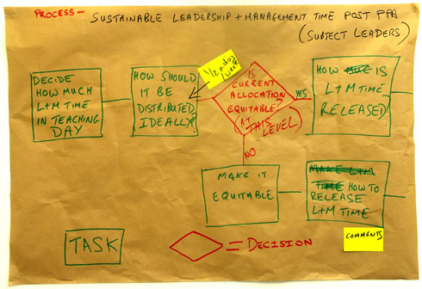
Stepwise method to conduct the modeling
Identify the process boundaries
Identify activities and events
Identify resources and their handovers
Identify the control flow
Identify additional elements (e.g. data objects, different types of events, exception handling…)
Notes:
Seeing all the BPMN constructs that we illustrated so far, it may be overwhelming to construct a process model at once.
This is a simple 5-step method for going from a blank sheet to a process model that you can incrementally refine.
From sticky notes to activities.

Slide 42
1. Identify the process boundaries
What are the process triggers?
What are the possible outcomes (positive/negative)?
Which perspective do we assume?
What artifacts are required as input and output to the process?
Purchase order received
Positive outcome: order fulfilled
Negative outcome: order rejected
Seller
Input: Purchase order
Output: Invoice, Shipment notice

Slide 43
Exercise 5.7
Identify the process boundaries for the procure-to-pay process de- scribed in Exercise 1.7 of Chapter 1 (page 30).

Slide 44
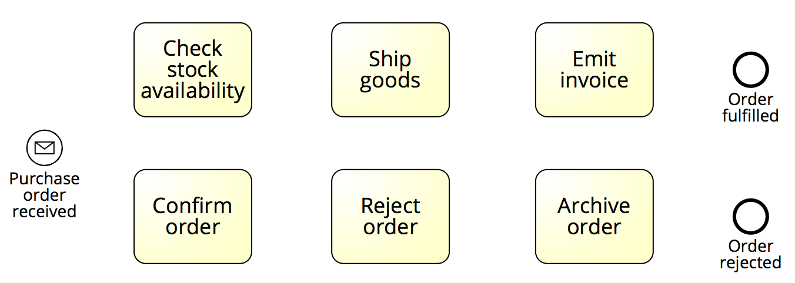
2. Identify activities and events

Slide 45
Exercise 5.8
Identify the main activities and events for the procure-to-pay process.

Slide 46
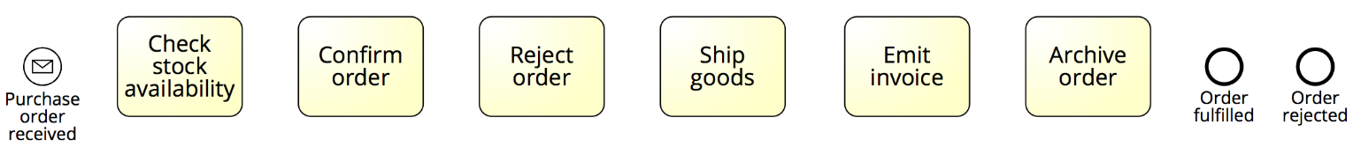
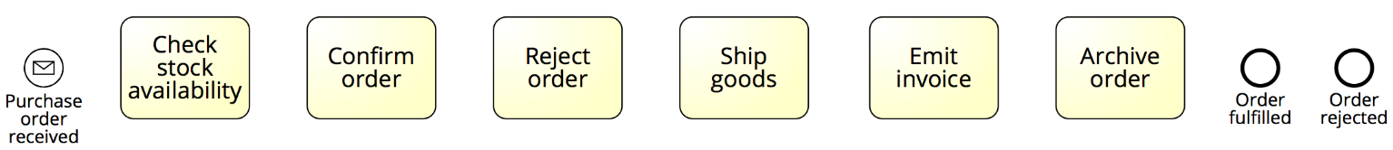
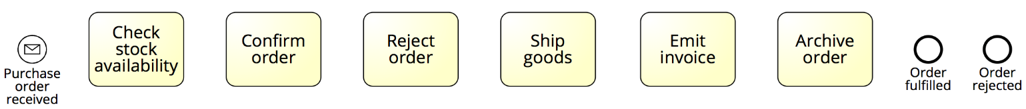


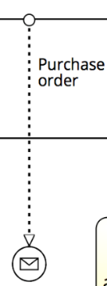
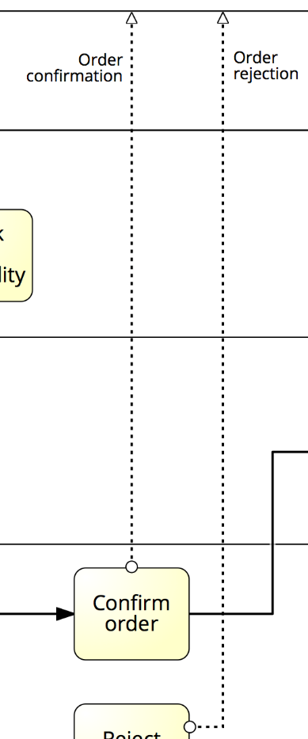
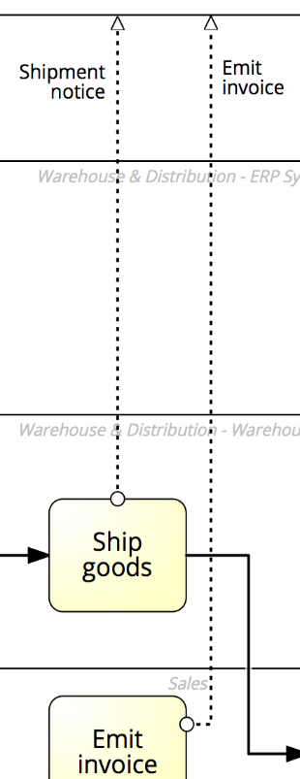

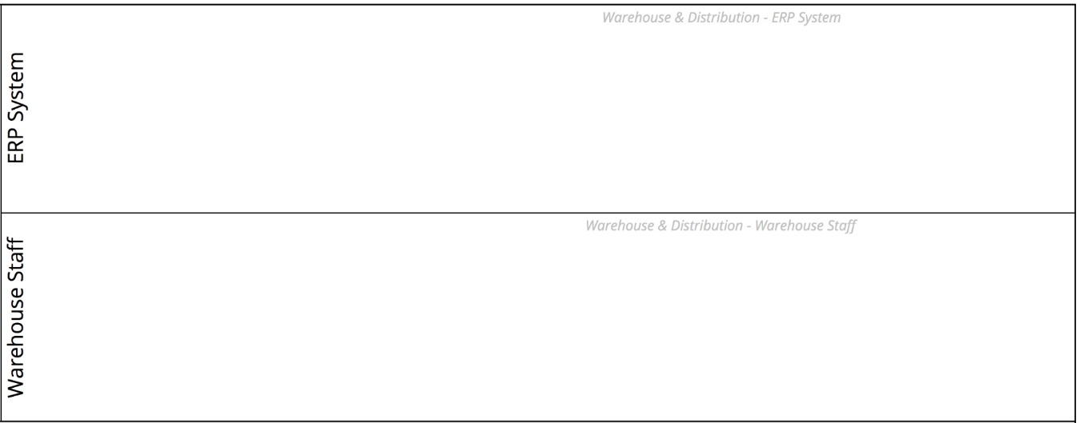

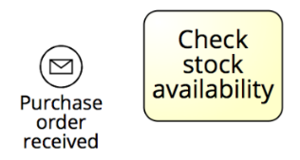
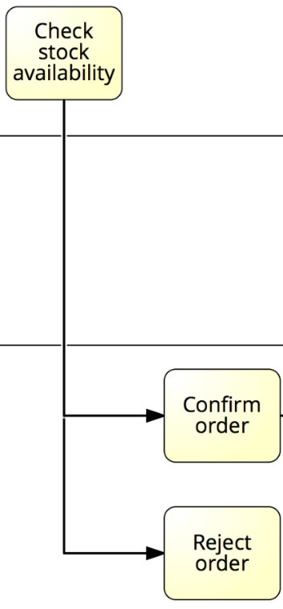
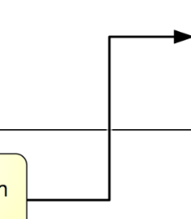
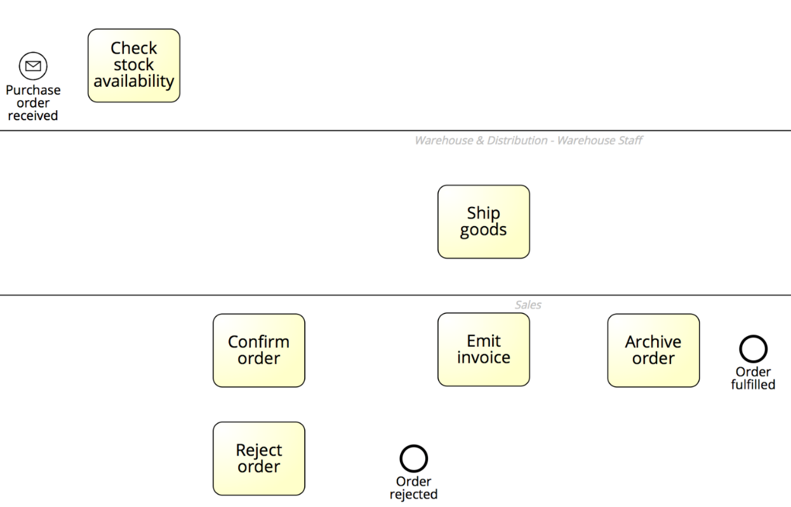

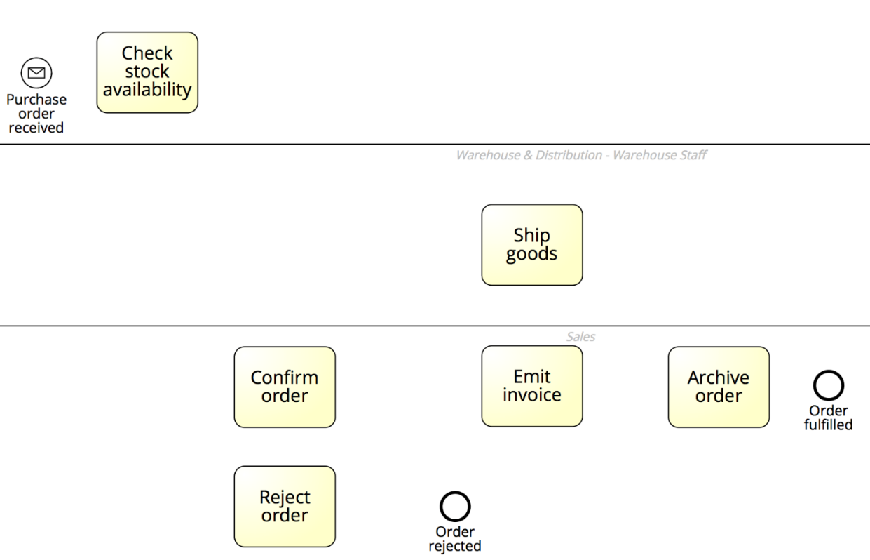
3. Identify resources and their handoffs
Notes:
Optionally, if we have another business party, we define the handover here or defer it to the last step (it’s not essential at this stage)

Slide 47
Exercise 5.9
Using the description of the procure-to-pay process, first identify the involved resources; next, assign the activities and events you obtained in Exercise 5.8 to these resources; and finally identify the handoffs.

Slide 48
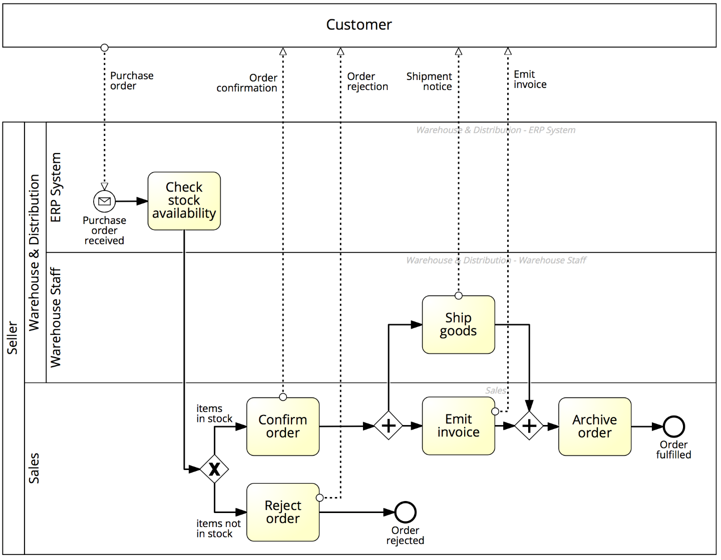
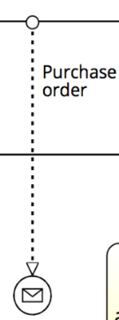

4. Identify the control flow

Slide 49
Exercise 5.10
Using the description of the procure-to-pay process, refine the model you obtained in Exercise 5.9 by defining the full control flow.

Slide 50
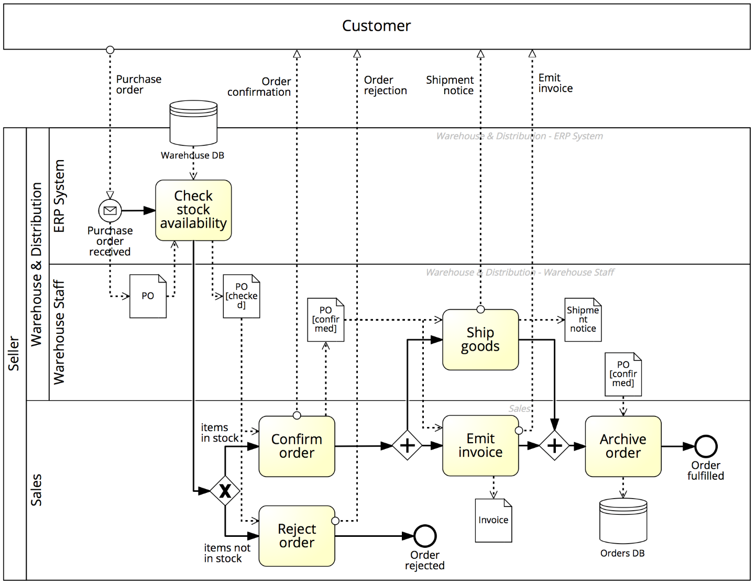
5. Identify additional elements

Slide 51
When should we stop modelling a process?

Slide 52
Exercise 5.11
Using the description of the procure-to-pay process, define the model you obtained in Exercise 5.10 by adding business objects and exception handlers.

Slide 53
Chapter 5: Process Discovery
Contents
The Setting of Process Discovery
Process Discovery Methods
Process Modeling Method
Process Model Quality Assurance
Recap

Slide 54
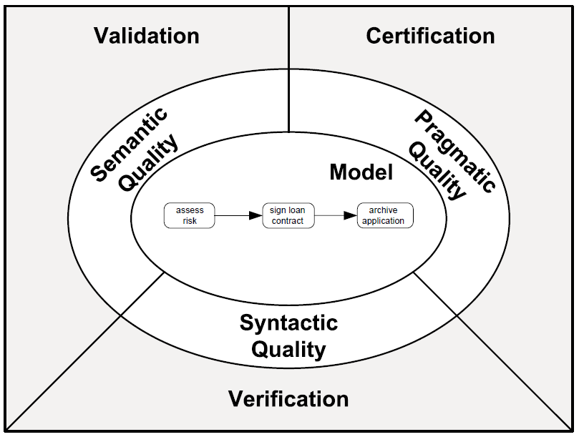
Process model quality assurance
Validity
Completeness
Understandibility
Mantainability
Learning
Structural correctness
Behavioral correctness

Slide 55
Syntactic quality: Verification
Syntactic quality relates to the conformance of a process model to the syntactic rules of the modeling language used.
Two types of syntactic rules: structural rules and behavioural rules.
A model is of high syntactic quality if it is syntactically correct:
Structurally correct +
Behaviorally correct

Slide 56
Structural correctness
A model is structurally correct if it satisfies the following syntactic rules:
Element-level rules:
activities must have at least one incoming and one outgoing sequence flow
start events must not have incoming arcs, end events must not have outgoing arcs
gateways must have exactly one incoming and at least two outgoing arcs (splits) or at least two incoming and exactly one outgoing arcs (joins)
…
Model-level rule: all flow nodes must be on a path from a start to an end event
i.e. no dangling arcs or disconnected nodes
implies that a model should have at least one start and one end event.

Slide 57
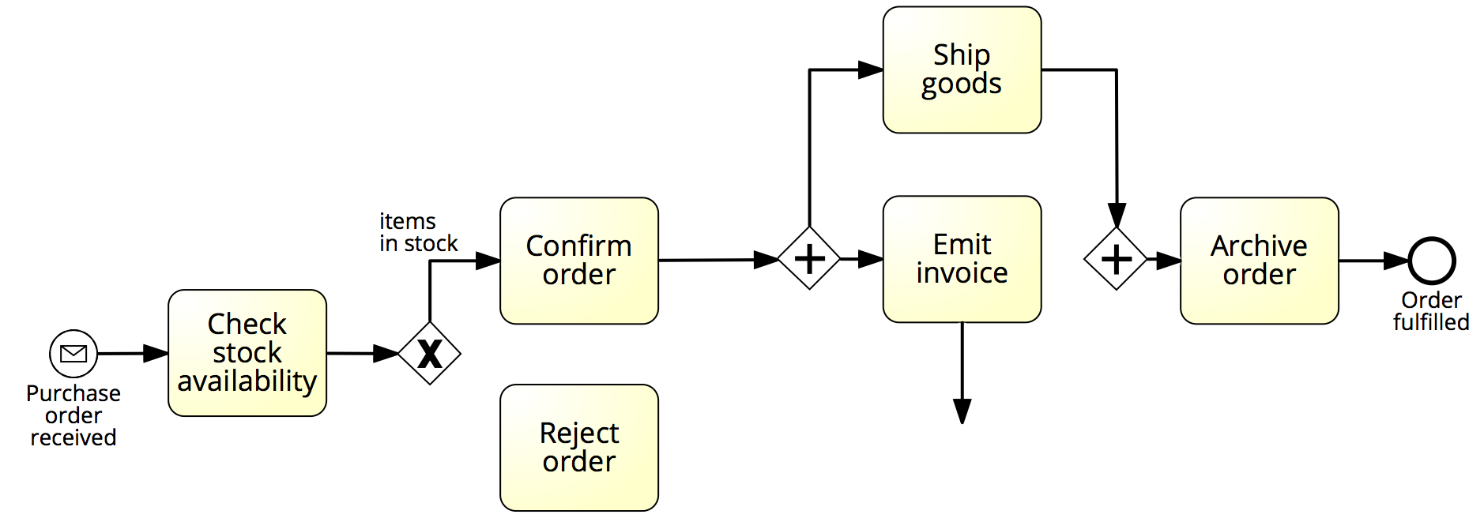
Example: structural correctness

Slide 58
Behavioral correctness (aka “soundness”)
A model is sound if it satisfies the following behavioral rules:
option to complete: any running process instance must eventually complete,
proper completion: at the moment of completion, each token of the process instance should be in a different end event, and
no dead activities: any activity can be executed in at least one process instance.

Slide 59
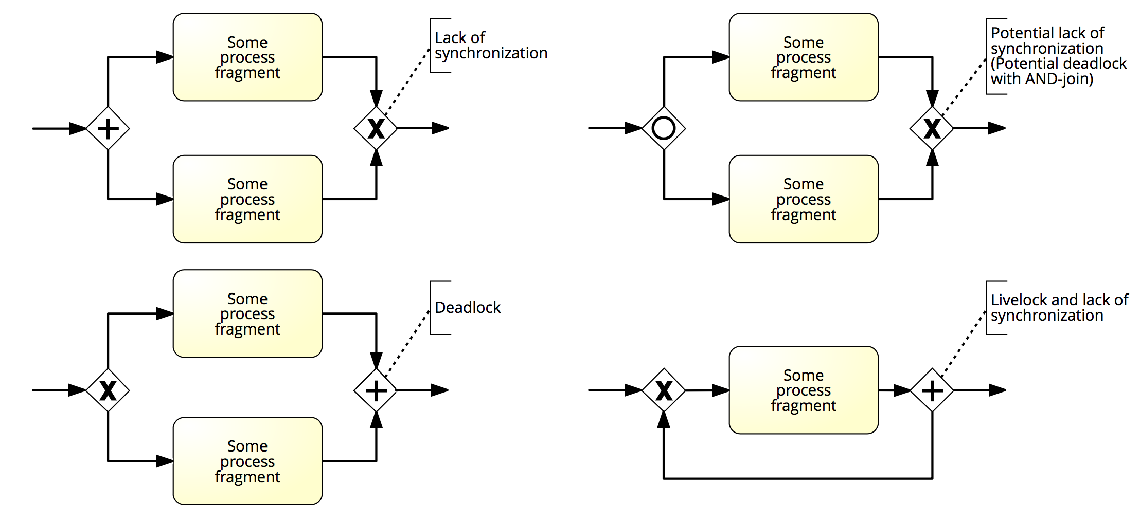
Exercise 5.12
Have a look at Figure 5.11. What is precisely going wrong in each block structure?

Slide 60
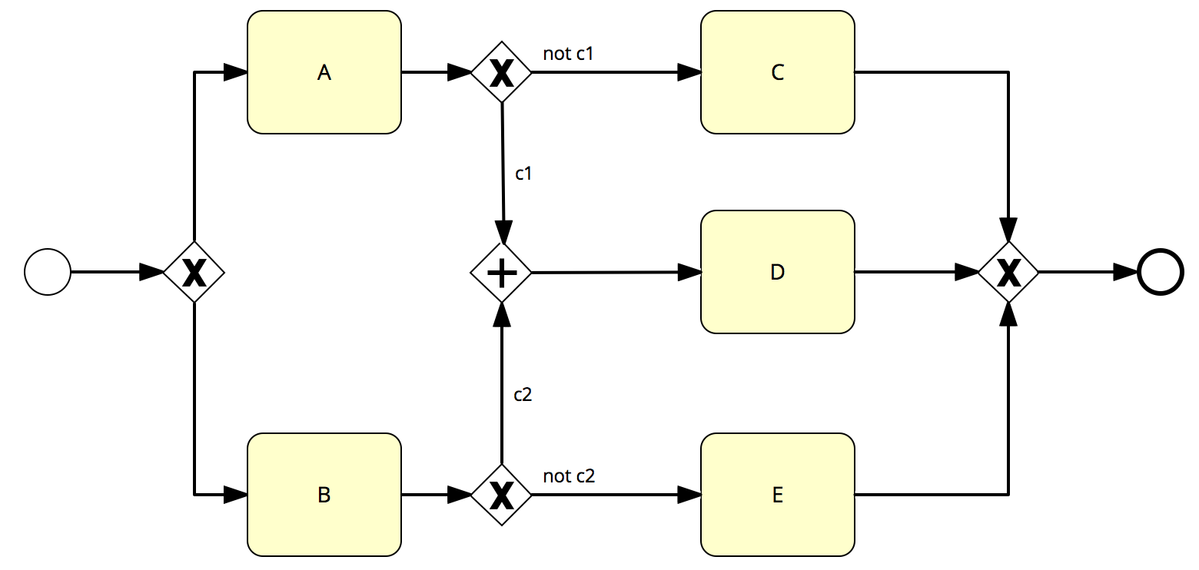
Example: no option to complete
If c1 is true after executing A, or c2 is true after executing B, the instance cannot complete (deadlock)
Note: this model also suffers from a dead activity (D)

Slide 61
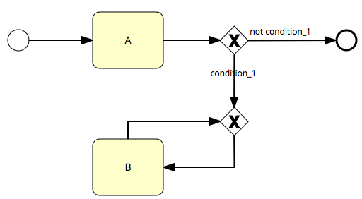
Example: livelock (no option to complete)
If condition_1 is true, the instance cannot complete and activity B will be repeated forever (livelock)
Note: this model is structurally incorrect, because B is not on a path to the end event

Slide 62
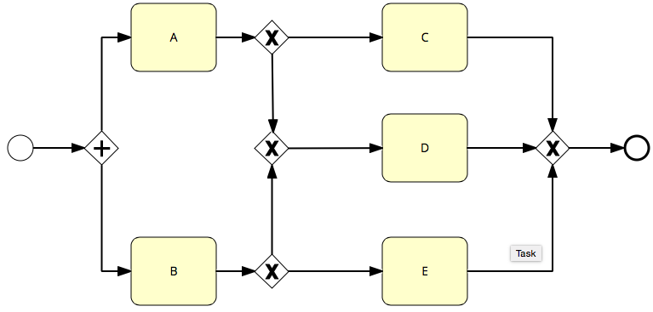
Example: no proper completion
At the moment of completion, there will be two tokens in the end event (lack of synchronization)

Slide 63

Example: dead activity
Even if this model can always complete, Activity D will never be executed
Note: this model also suffers from a deadlock, as a token will be left behind (stuck before the AND-join). However, there is always an option to complete

Slide 64
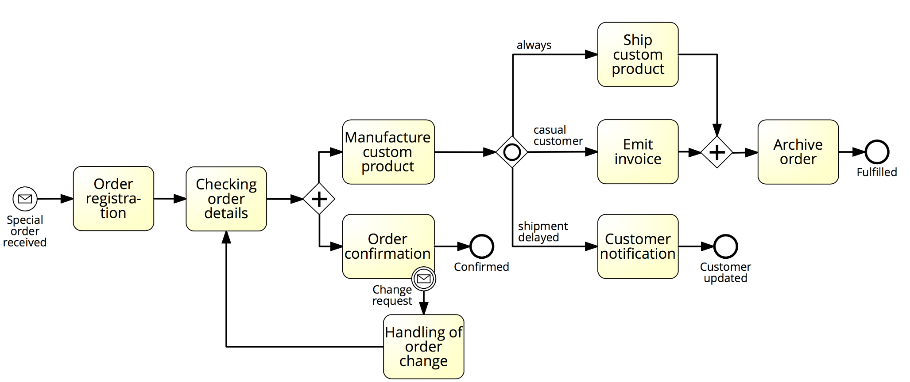
Exercise 5.13
Fulfilment of special orders
Which behavioral rules are violated in the model below?
How can this model be made sound?

Slide 65
Semantic quality: validation
Semantic quality relates to the adherence of a process model to its real-world process.
Validation is the activity of checking the semantic quality of a model by comparing it with its real-world business process.
A model is of high semantic quality if it is semantically correct:
Valid (all model instances are correct and relevant) +
Complete (all possible process instances are covered)
Domain Expert
Process Analyst

Slide 66
Semantics
Meaning of the various elements
Activities model something actively performed during the process
Events model something happening instantaneously during the process
AND gateways model parallelism
XOR gateways model exclusive decisions and simple merging points
OR gateways model inclusive decisions and synchronizing merging points
+
Meaning of the whole business process model
“This model captures an order fulfilment process that takes place at a seller. The model starts with the receipt of an order…”

Slide 67
Exercise 5.14
Consider the following process description.
A company has two warehouses that store different products: Amsterdam and Hamburg. When an order is received, it is distributed across these warehouses: if some of the relevant products are maintained in Amsterdam, a sub-order is sent there; likewise, if some relevant products are maintained in Hamburg, a sub-order is sent there. Afterwards, the order is registered and the process completes.

Slide 68
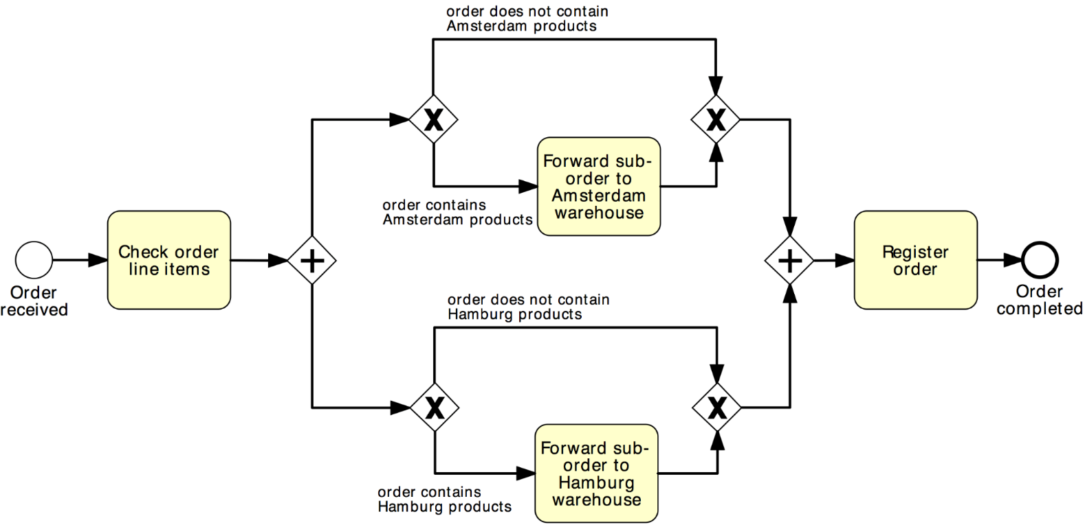
Exercise 5.14 (cont’ed)
What can we say about the semantic quality of this model?
Invalid
It is not possible that products are neither in the Amsterdam nor in the Hamburg warehouse.

Slide 69
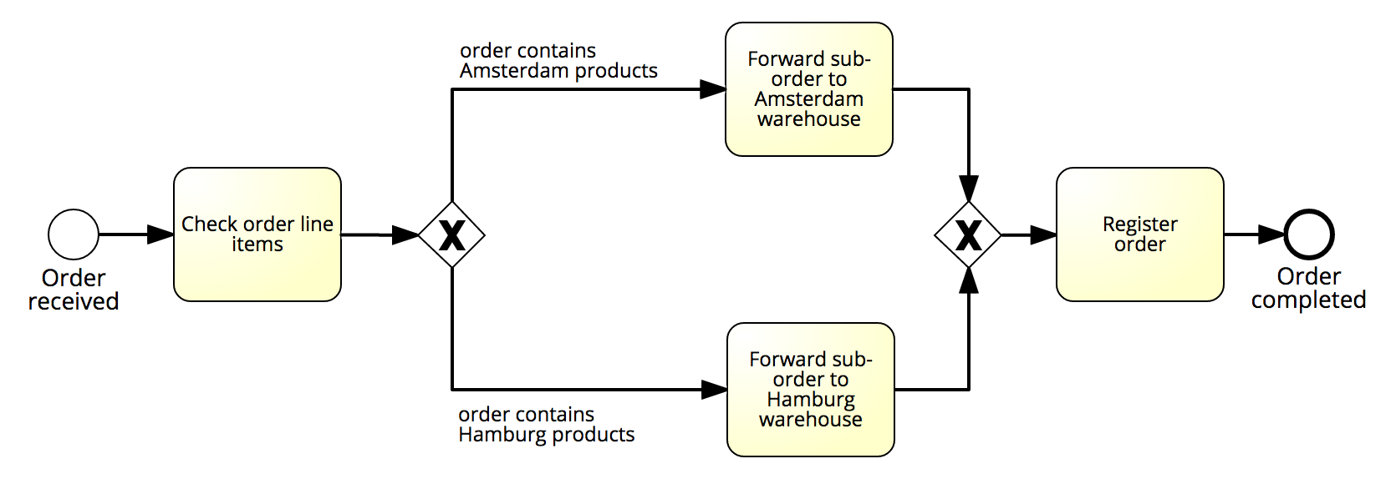
Example: semantic correctness
And about this one? (with reference to the same description)
Incomplete
Orders may contain both products that are in Amsterdam and products that are in Hamburg

Slide 70
Exercise 5.15
Consider the model in the next slide, with reference to the following process description. Is this model valid and complete? If not, what statements are invalid and what is missing?
When a special order is received, it is first registered and then its details are checked. Next, the order is confirmed and meantime the custom product is manufactured. Once the product has been made, the shipment can be planned. Afterwards, the customer type and shipment status are checked. In fact, if a customer is casual an ad hoc invoice must be emitted, which is not required for ordinary customers. In the latter case, the customer account is simply charged with the costs related to the order fulfillment. Moreover, if the shipment has been delayed, the customer must be updated on the expected delay. Concomitantly to these activities, the custom product is shipped. After the latter activity and after the invoice has been emitted, the process completes with the archival of the order. Any time during the confirmation of the order and the manufacturing of the respective product, an order change request may be received, in which case any activity must be interrupted to handle the change re- quest. This includes the registration of the order variation and a notification to the customer, after which the process resumes from the order checking.

Slide 71
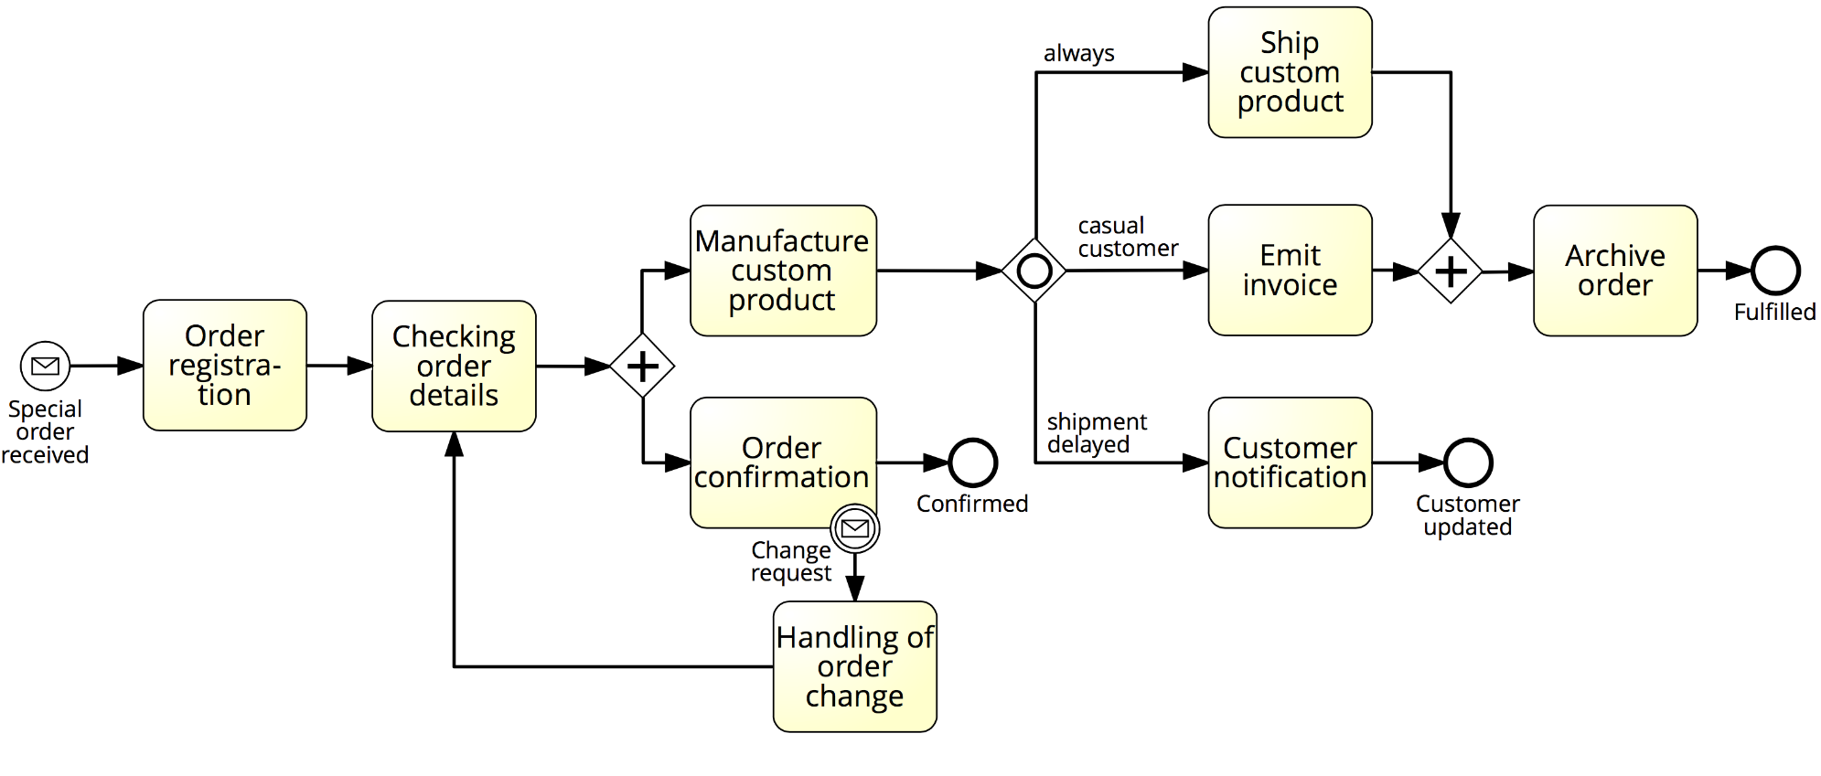
Exercise 5.15 (cont’ed)

Slide 72
Pragmatic Quality: Certification
Pragmatic quality relates to the usability of a process model
Challenge = anticipate the particular usage of the model
Usability:
Understandability: how easy it is to read and comprehend the model
Maintainability: how easy it is to apply changes
Learning: how good a model reveals how its corresponding process works in reality
Model characteristics that influence usability include size, structural complexity and layout

Slide 73
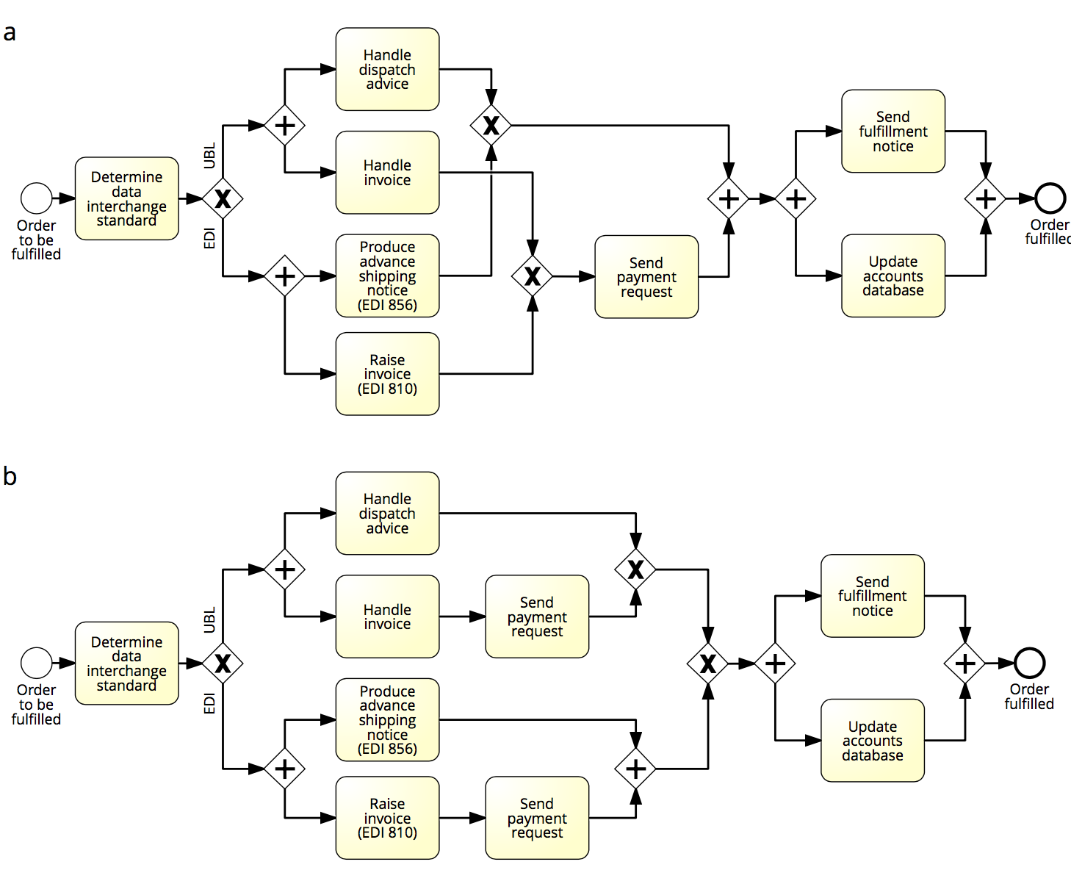
Example: block-structuring a model

Slide 74
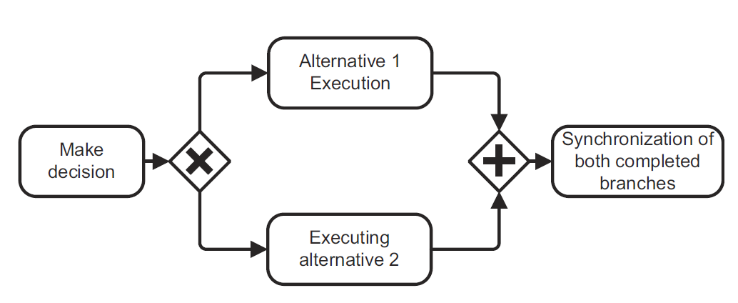

Is this process model of good pragmatic quality?
Different labeling styles
Noun phrase
Verb phrase
(imperative)
Noun phrase
(using “of”)
Verb phrase
(gerund)

Slide 75
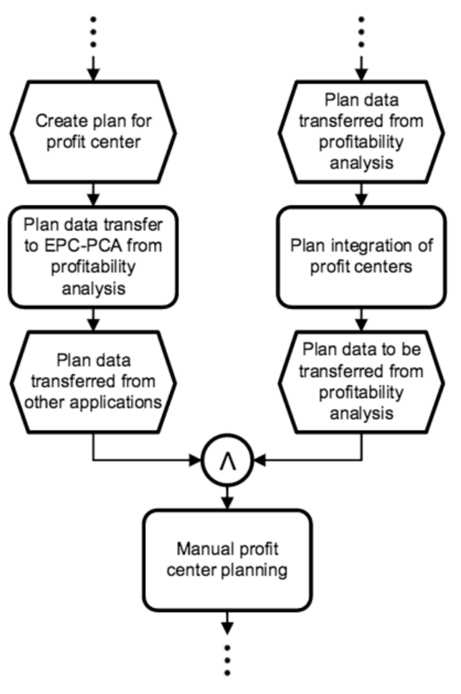
Example: A model from the SAP R/3 collection…

Slide 76
Exercise 5.16
Is the process model below of good pragmatic quality? If not, how can it be improved?

Slide 77
Modeling Guidelines and Conventions
Used to improve pragmatic quality by restricting:
Vocabulary (e.g. banning the use of the OR gateway)
Structure (e.g. limiting the size of a model to max 30 nodes)
Semantics – rare (e.g. using data objects to only capture information flow)
Appearence (e.g. enforcing a particular labeling or layout style)

Slide 78
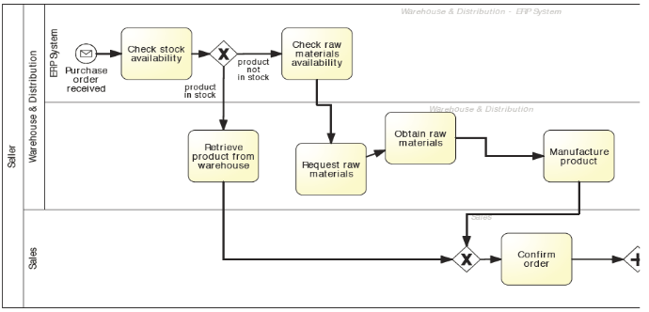
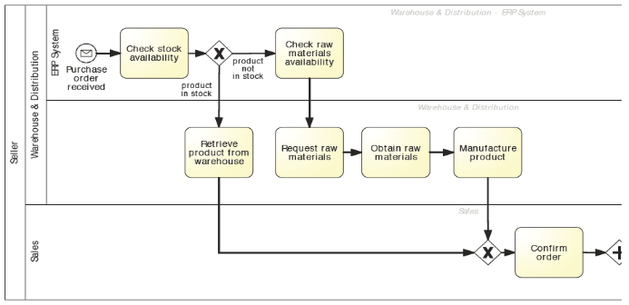
Example: modeling guidelines and conventions
Labeling
Activities as imperative verb + noun
Events as noun + past-participle verb
Conditions on outgoing arcs of (X)OR-splits with reference to object
Layout
From top-left to bottom-right
Use direct arcs with no crossing where possible

Slide 79
Example modelling guidelines: 7PMG
G1 Use as few elements in the model as possible
G2 Minimize the routing paths per element
G3 Use one start event (per trigger) and one end event (per outcome)
G4 Model as structured as possible
G5 Avoid OR gateways where possible
G6 Use verb-object activity labels
G7 Decompose a model with more than 30 elements

Slide 80
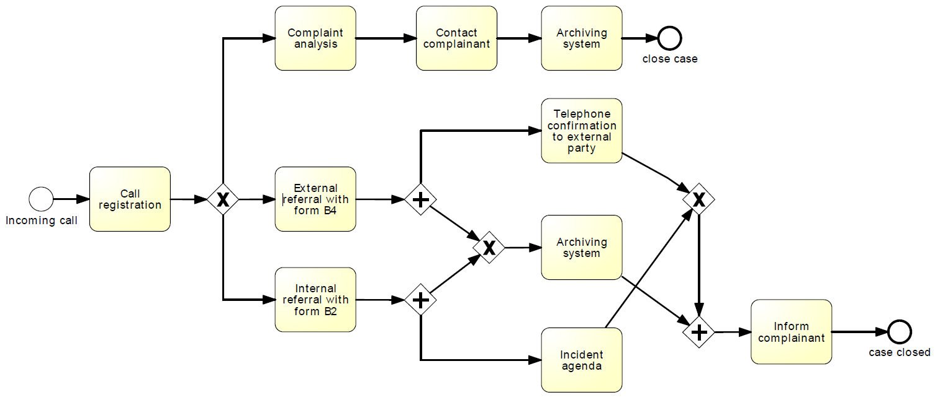
Exercise 5.17
Which 7PMG can be applied to this model? Consider the description below.
A complaint is triggered by a phone call by a complaining customer. It is decided whether the complaint can be handled or whether it has to be referred to an internal or external party. An external referral leads to a telephone confirmation to the external party. An internal referral is added to the incident agenda. If no referral is needed, a complaint analysis is conducted and the complainant is contacted. In either case, the complaint is archived and the case is closed.

Slide 81
Chapter 5: Process Discovery
Contents
The Setting of Process Discovery
Process Discovery Methods
Process Modeling Method
Process Model Quality Assurance
Recap

Slide 82
Recap
For Process Discovery, we have to define the setting, gather information, conduct modeling and assure model quality
There are various discovery methods such as document analysis, observation, automated process discovery, interviews and workshops
A modeling method proceeds by identifying the process boundaries, then activities and events, resources and their handoffs, control flow and additional elements
Quality assurance relates to syntactic, semantic and pragmatic quality

